Slide 1

Anna Johnson
Joe Goldsich
Kyle Son
Bill Yerkes
Analysis for determination of a relationship
between energy demand and weather.
CSEE5590 – Big Data Programming

Slide 2

Content
Introduction
Background
Goals and Objectives
Motivation
Significance
Objectives
Model
Dataset
Analysis of data
Implementation
Results Evaluation
Conclusion
Future Work
Notes:
Joe

Slide 3
Introduction
Information overload can make it difficult to understand issues and solve problems.
The appearance of excessive quantity of information prevents the understanding of the problem and the ability to construct a solution to the problem.
Big Data technologies takes this paradigm and turns it inside out.
The students working on this project are going to attempt to construct a model which will be able to take weather and energy related data to be able to forecast energy demand.
Notes:
Anna

Slide 4
Background
Is it possible to use weather forecasting to predict energy demand?
The energy industry is researching this and have already create models to make predictions.
Data Scientist are also researching this topic and have published articles about this topic.
Our team is going to try our hand at this and see if we can apply the knowledge we have gained through this course and come up with our own model and results.
Notes:
Anna

Slide 5
Motivation
The global population continues to increase, and the weather patterns seem to be getting more extreme, from extending periods of both above and below normal temperatures in various parts of the world and in the United States.
The demand and consumption of energy increase with the population and with the extreme weather, the need for air conditioning in the summer and for heating in the winter.
The recent crisis in Texas has demonstrated what can happen if the energy providers are not able to meet the demands of the consumers.
Being able to forecast accurately future demand and plan accordingly can help prevent or mitigate such crises in the future
Notes:
Kyle

Slide 6
Significance
Better planning of resources for Utility Companies can result in reduced cost to the consumers and more reliable service. This also dips into the area of public safety, as loss of power during extreme weather with no warning can be dangerous for vulnerable groups.
Notes:
Bill

Slide 7
Objectives
Utilize the tools and technologies learned from CSEE 5590 to be able to analyze collected data so that it will be possible to determine if there is a relationship between weather and energy consumption and if a relationship exists determine the possibilities of using that relationship to predict future energy needs.
Notes:
Anna

Slide 8
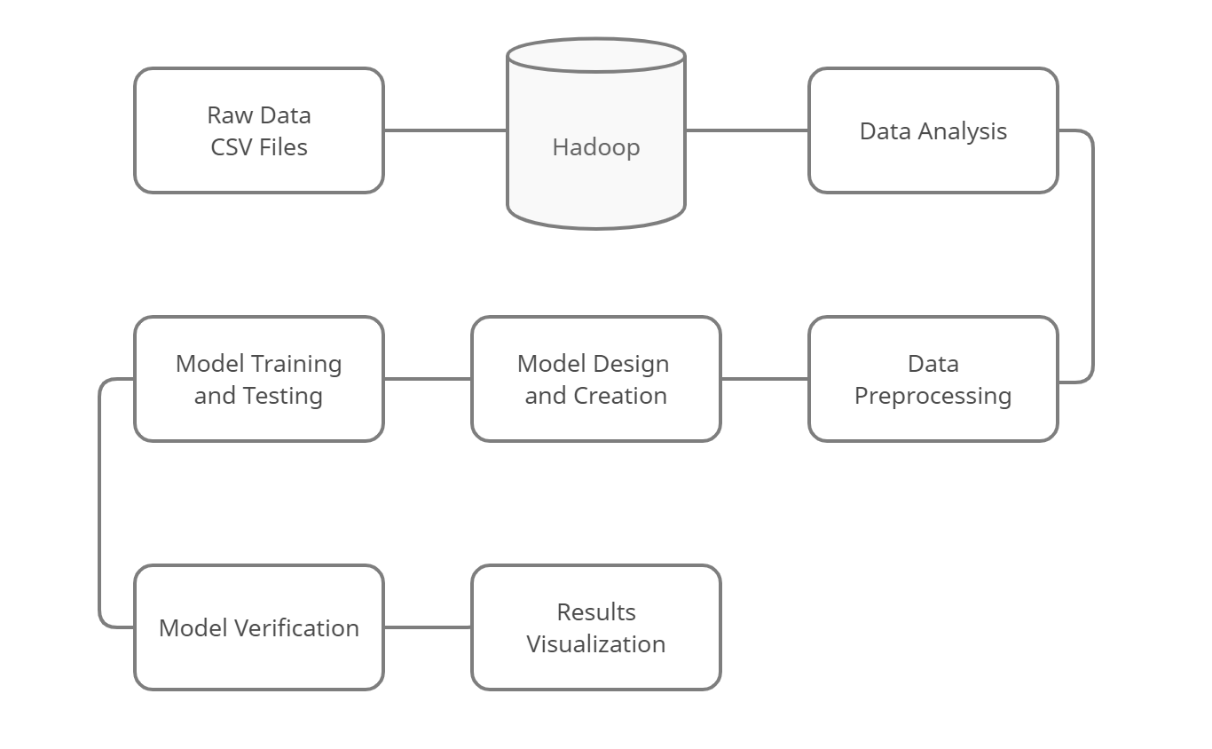
Model

Slide 9
Dataset
This dataset contains 4 years of electrical consumption, generation, pricing, and weather data for Spain.
Consumption and generation data were retrieved from ENTSOE a public portal for Transmission Service Operator (TSO) data.
Settlement prices were obtained from the Spanish TSO Red Electric España.
Weather data was purchased as part of a personal project from the Open Weather API for the 5 largest cities in Spain and made public on Kaggle.
Notes:
Joe

Slide 10
Analysis of Data-Preprocessing
Data preprocessing began iteration two, utilizing Hive, MapReduce, Sqoop with MySQL, storing the data in Hadoop.
The preprocessing and analysis of the data continued into the first part of iteration three, performing similar task, but utilizing Spark now.
Records and Columns with missing data were removed from the dataset.
The issue concerning the date time field was resolved in the beginning of iteration three.

Slide 11
Analysis of Data
Metrics on the features of the data were compiled.
Min, Max, Median, Mean, 1st Quarter, 3rd Quarter.
Relationship between the feature were compared.

Slide 12
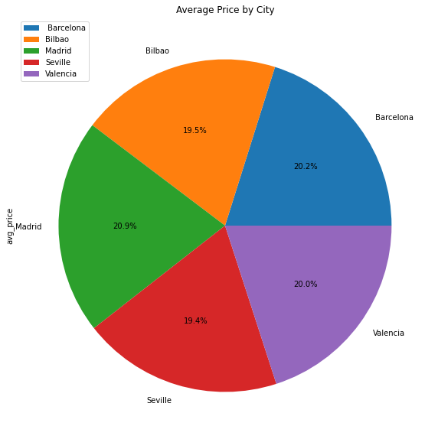
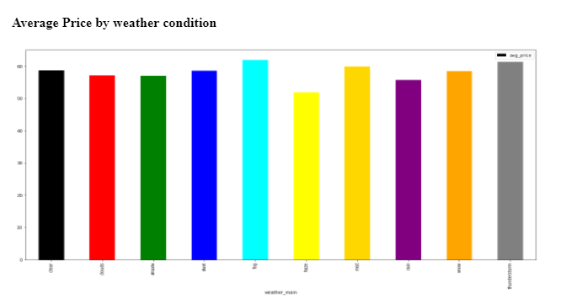
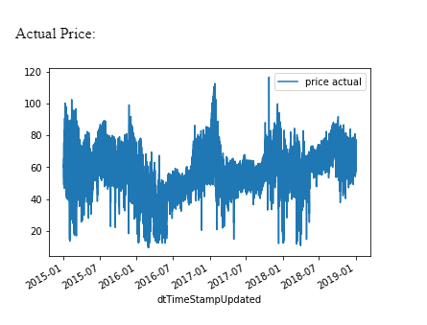
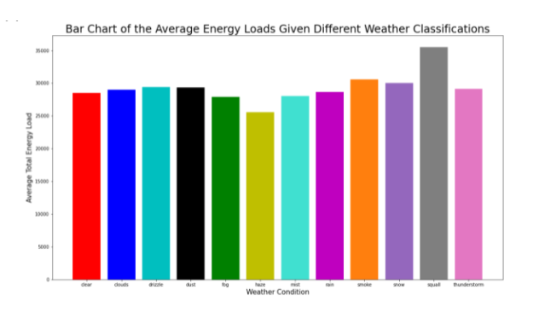
Analysis of Data

Slide 13
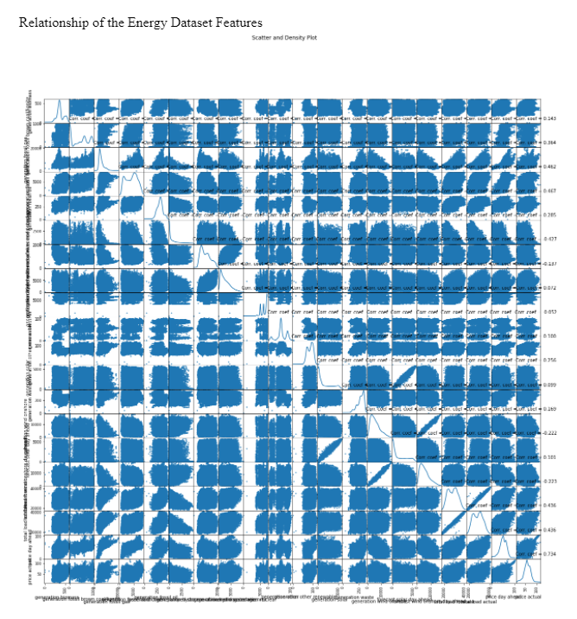
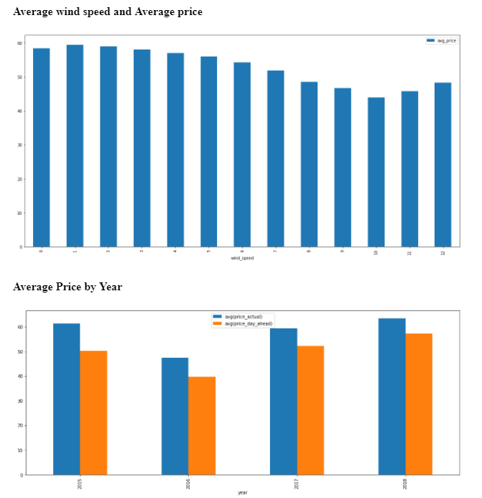
Analysis of Data

Slide 14
Implementation
Resolving the issue with the Date Field
Linear Regression
Long Short Term Memory Model
Ridge Model
Lasso Model
Elastic Model

Slide 15
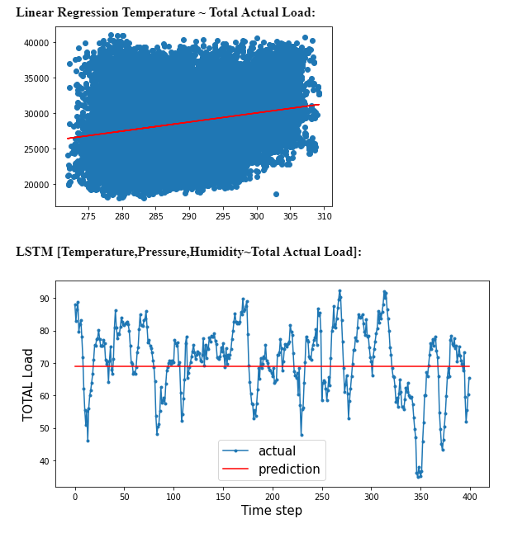
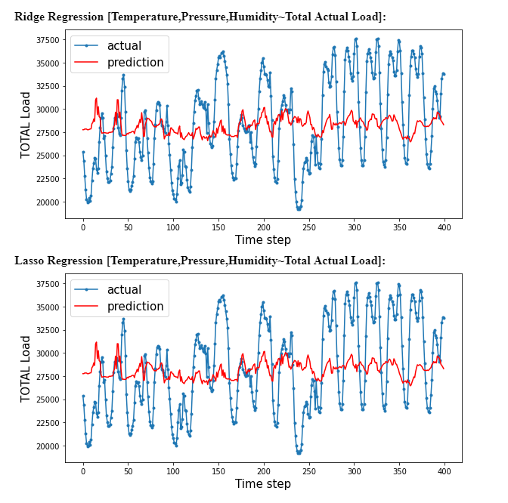
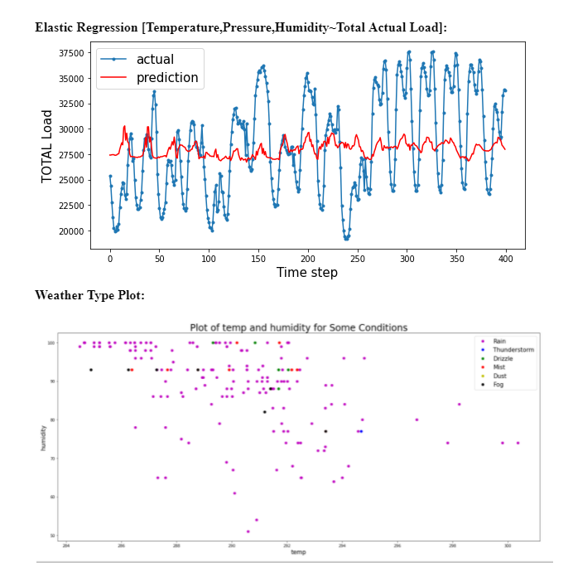
Results Evaluation

Slide 16
Conclusion
The team has familiarized themselves with the tools learned over the semester. The team has also investigated the two datasets to be able to better understand how to construct our solution. The team has received exposure to how Big Data can be used to solve real world problems.

Slide 17
Future Work
Future work and plans would include to expand on the level of ML knowledge, both via coursework and independent learning. Improve or even create new and different prediction models.
Locate other sources of data to be able to build better and more robust models.
Explore concepts of semily dissimilar areas being able to predict the behavior of other areas, such as weather and pollution, or movie preferences based upon consumer spending patterns.

Slide 18
Q & A

Slide 19
THANK YOU

